Slide 1
Predicting the Place to Setup a restaurant in Delhi
Submitted by : Jaskirat Singh Nandhra
jaskiratnandhra@gmail.com

Slide 2
Introduction
Delhi is the capital city of India and is regarded as the heart of the nation. The city is popular for its enriched culture and heritage. The city hosts some famous historical monuments and is developing with the passing of time.
Delhi undoubtedly is India’s culinary capital and the soul of the city is intricately connected to the vast array of food options available all throughout it. Offering the kind of multiculturalism that is also reflected in the town’s museums, bars and events scenes, the best restaurants in Delhi include an expansive spread of Asian, Mediterranean, European and, of course, Indian meals.

Slide 3
Problem Description
The objective of this Capstone Project is to analyze and select the best locations in the city of Delhi , India to open a new restaurant . Using data Science Methodology and machine learning techniques like clustering . This project aims to provide solutions to the business Question "What is the best and recommended locations in the city of Delhi to open a new restaurant?"

Slide 4
Data Sources
Neighbourhood Data :The data of the neighbourhoods in Delhi can be extracted out by web scraping using Beautiful Soup library for Python. https://en.wikipedia.org/wiki/Neighbourhoods_of_Delhi and https://www.mapsofindia.com/pincode/india/delhi/
Coordinates of those Neighbourhoods : The latitude and longitude of the neighbourhoods are retrieved using Geocoder Module. The geometric location values are then stored into the initial dataframe.
Venue Data for those neighbourhoods : From the location data obtained after Web Scraping and Geocoding, the venue data is found out by passing in the required parameters to the FourSquare API, and creating another Data Frame to contain all the venue details along with the respective neighbourhoods.

Slide 5
Target Audience
The objective of this Project is to locate and recommend to the management which neighbourhood of Delhi will be best choice to start a new restaurant in Delhi. The Management also expects to understand the rationale of the recommendations made.
This would interest anyone who wants to build a new restaurant in Delhi.

Slide 6
REsults
The neighbourhoods are divided into k clusters where k in sthe number if clusters found using optimal approach. The clustered neighbourhoods are visualized using different colour so as to make them distinguishable. The clusters in each neighbourhood has similar characteristics when it comes to setting up of a new restaurant.
Cluster 0 (Red) – These clusters are present on the outskirt of Delhi
and have fewer number of restaurants since they are sparsely populated
Cluster 1(Navy Blue) – These clusters are present besides the heart of the capital city of Delhi and have large number shops and fast food joints. But still the number of restaurants present in this cluster are less than all the other clusters.
Cluster 2(Sky Blue) – These clusters are present with in the heart of the capital city of Delhi and have large number of restaurants since they are largely populated
Cluster 3(Yellow)- These clusters are present through the city and the number of restaurants is good but are less than the Cluster number 2.

Slide 7
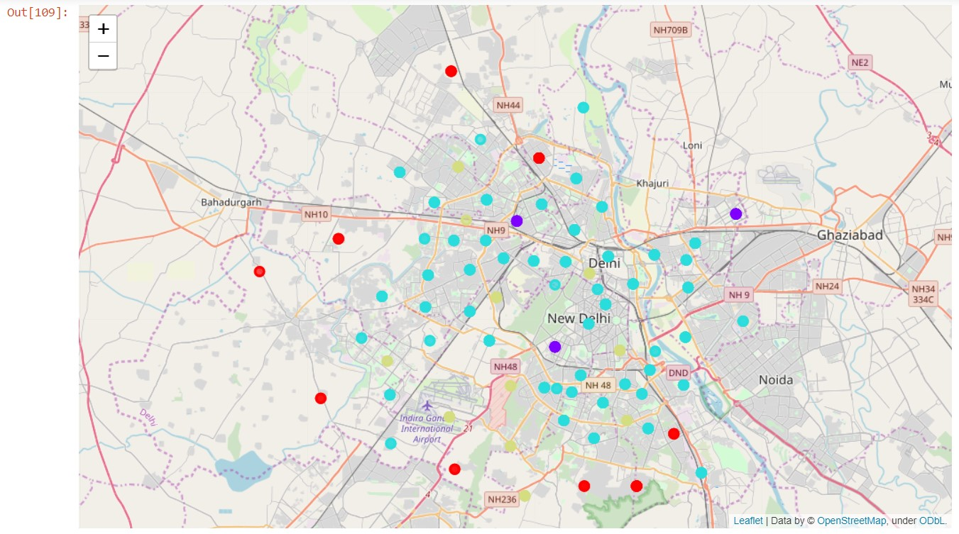

Slide 8
Based on these Clusters , it is very clear that there are less restaurant in Cluster 0 ,Cluster 1 and Cluster3 respectively. So there is a scope to establish a restaurant which does not need to complete with already existing and well established restaurant.
Also, if we observe Cluster 0 is completely outskirts (refer map ) and situation may arise that there will not be enough customers available in those areas. At the same time , Cluster 3 has less restaurant but is in the heart of the city.
Also the cluster 1 has less number of restaurant and has various discounted stores and shops and Scenic Lookout stores, which means this is the right cluster to invest in restaurant as there are customers who can be attracted towards our restaurant due to the lack of proper restaurant in this cluster.

Slide 9
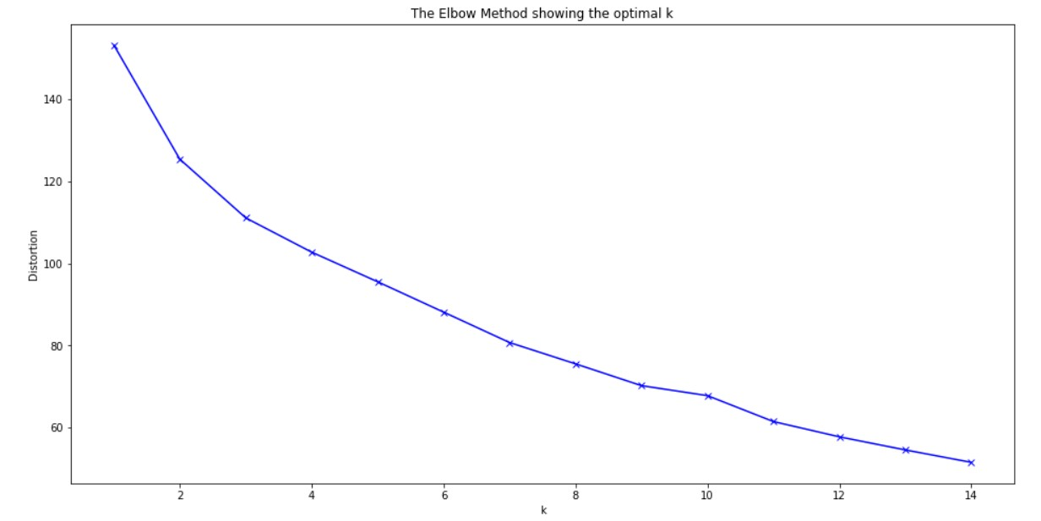
Also we have chosen k=4 as the number of cluster based on the Elbow Method in the plot of distortion vs ‘k’.

Slide 10
Conclusion
The conclusion that we draw form this project is that the cluster 1 is the best suited area for the setting up of a restaurant in delhi.
In this project we have gone through the process of identifying the business problem specifying the data required, extracting and preparing the data, performing machine learning by clustering the data into 4 clusters based on their similarities and lastly providing recommendation to the relevant stake holder i.e. property developers and investors regarding the best location to open a new restaurants . Please note that Population and Income of residents are two important factors which can be considered for future research purpose on this topic .

